Slide 1
Progress Report
7/8
HJ. Kwon
Progress Report
NCC-GCSP

Slide 2
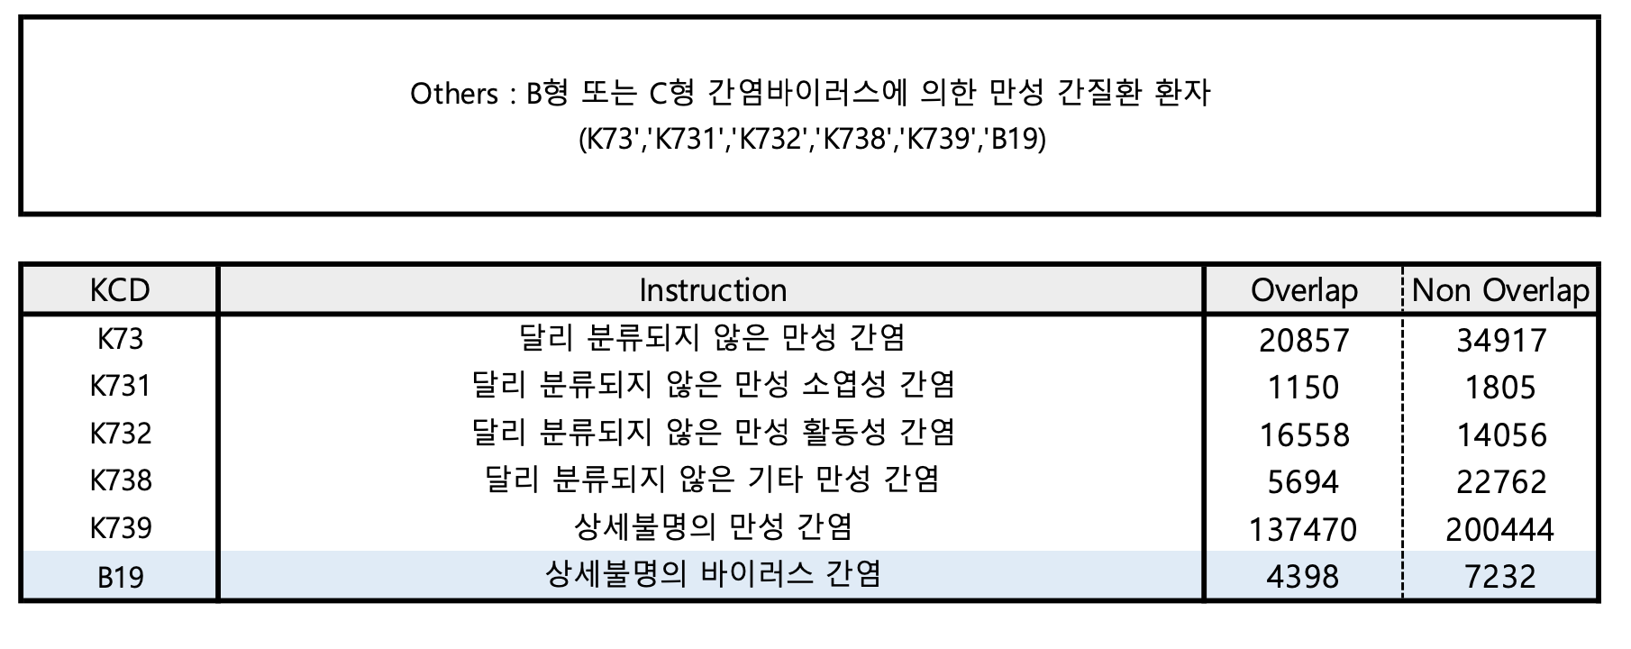
Markov Model - Others Distribution
HJ. Kwon
Progress Report
NCC-GCSP

Slide 3
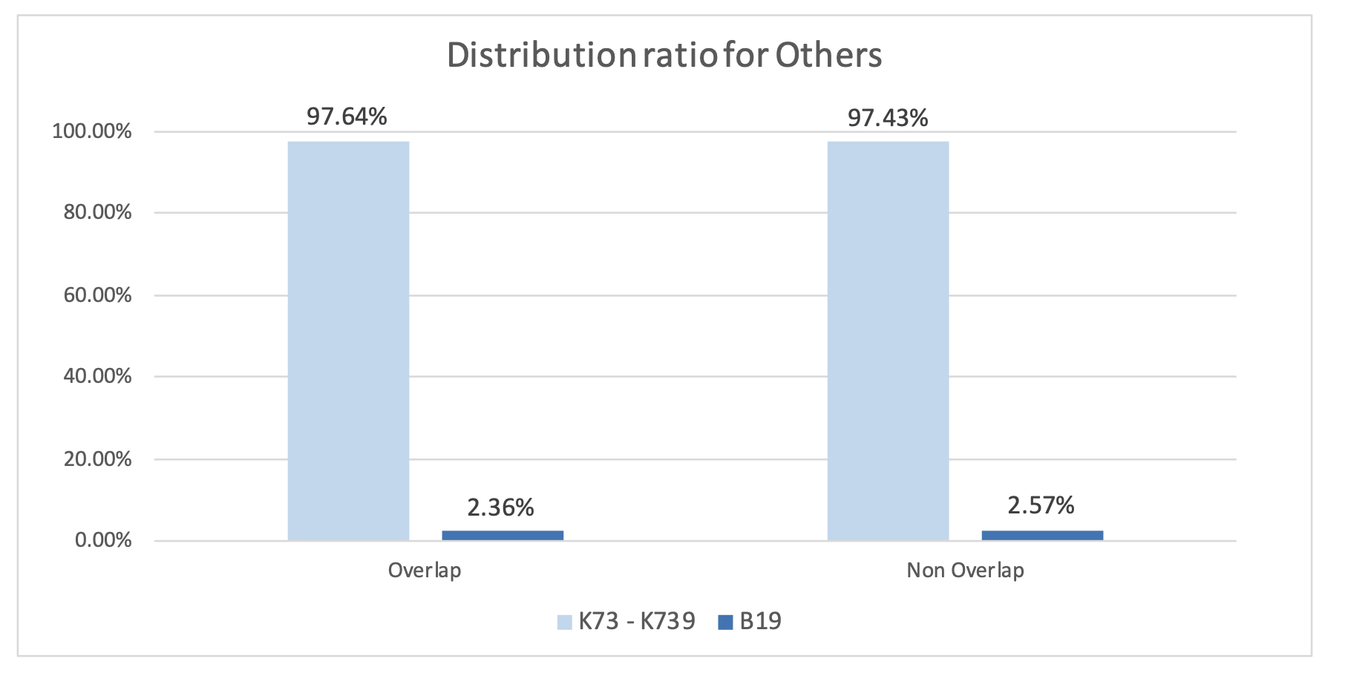
Markov Model - Others Distribution
∴ 바이러스 간염에 해당하는 B19의 경우 전체 Others에서 차지하는 비율이 미미하기 때문에 별도로 분리 X
HJ. Kwon
Progress Report
NCC-GCSP

Slide 4
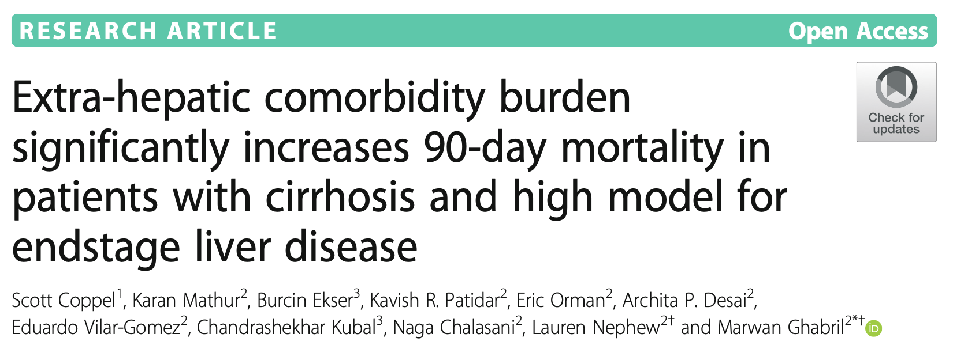
Markov Model - CCI Distribution
Determine CCI Score Baseline
HJ. Kwon
Progress Report
NCC-GCSP

Slide 5
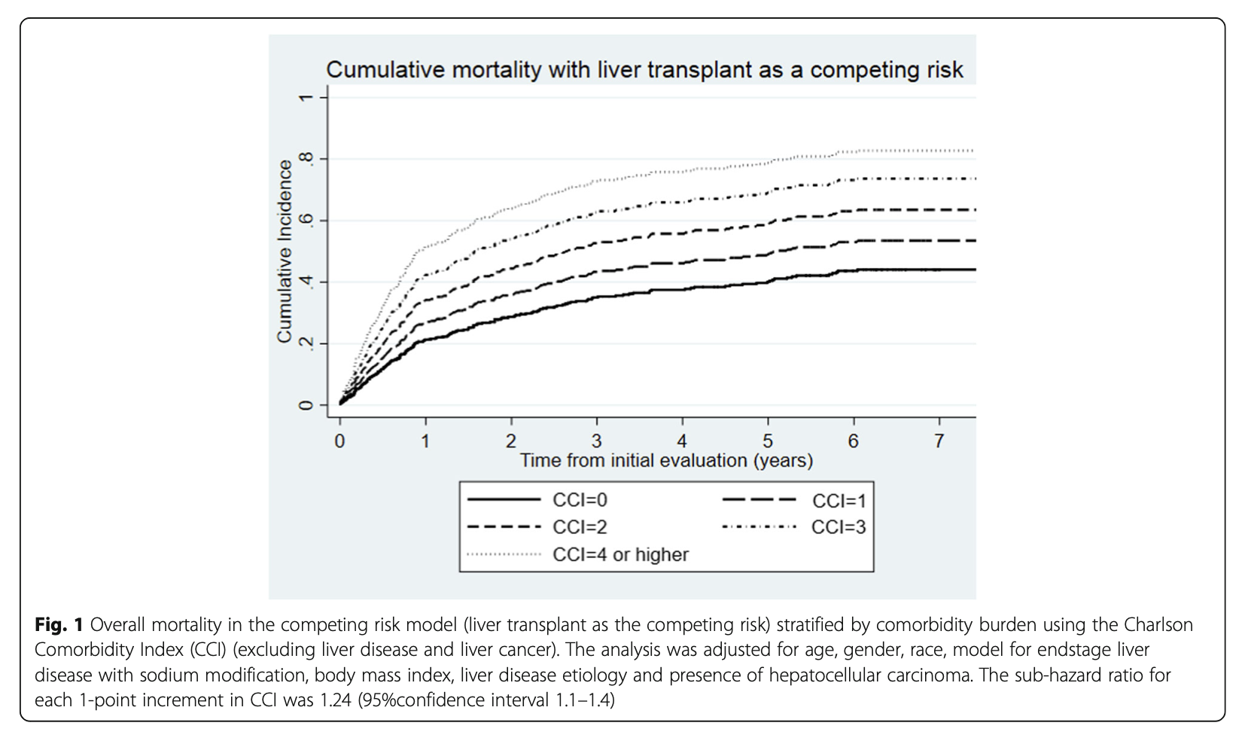
Markov Model - CCI Distribution
HJ. Kwon
Progress Report
NCC-GCSP

Slide 6
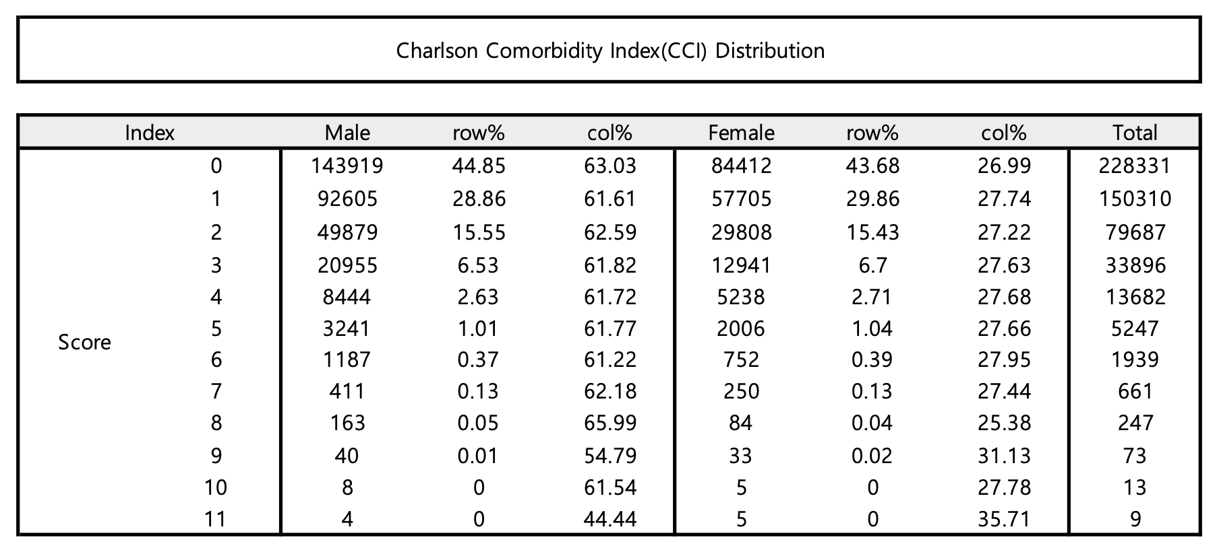
Markov Model - CCI Distribution
HJ. Kwon
Progress Report
NCC-GCSP

Slide 7
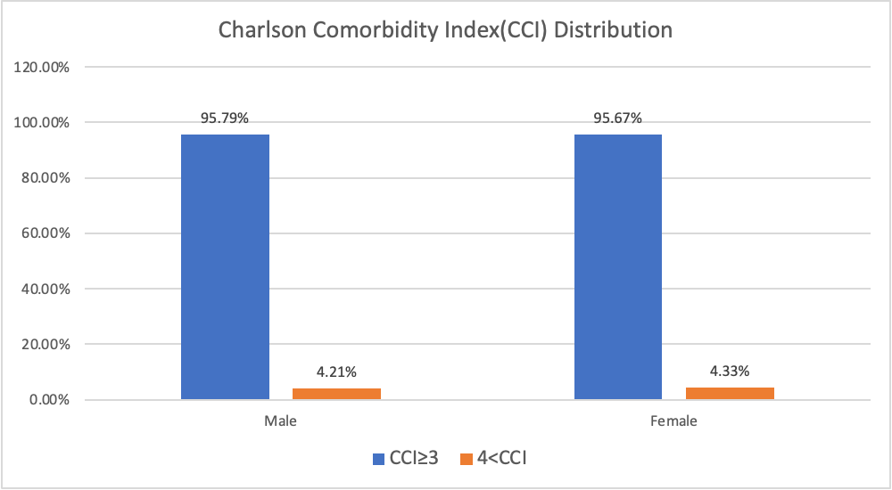
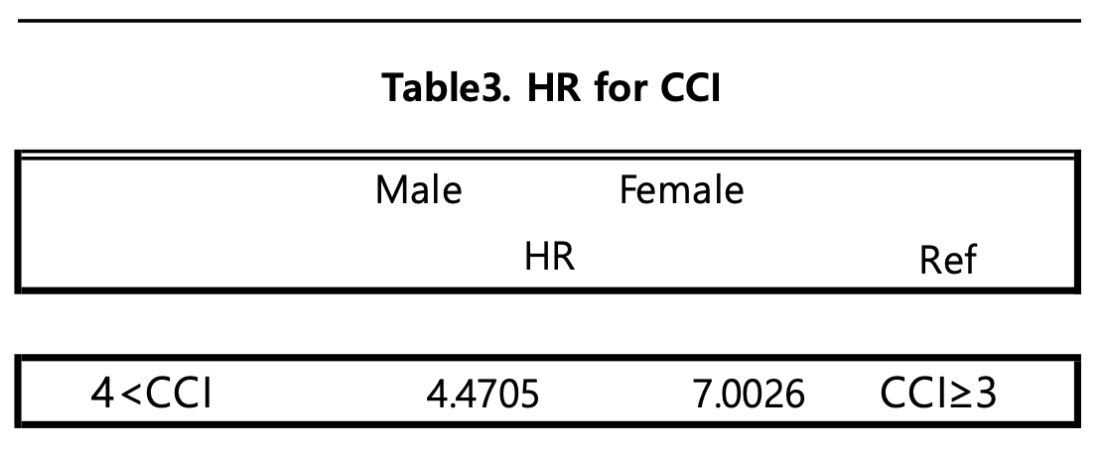
Markov Model - CCI Distribution
* Only Hepatitis B exist
HJ. Kwon
Progress Report
NCC-GCSP

Slide 8
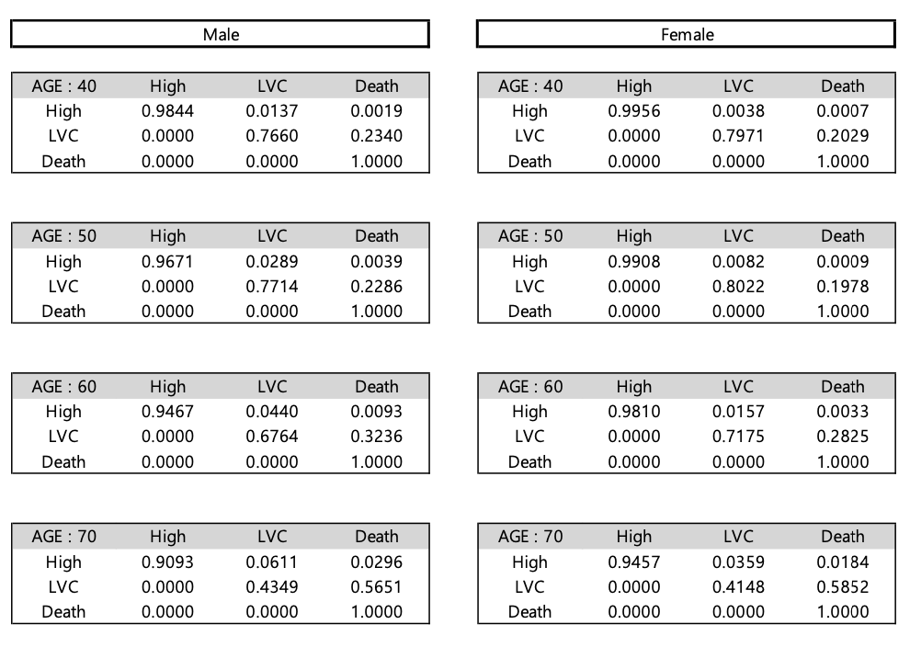
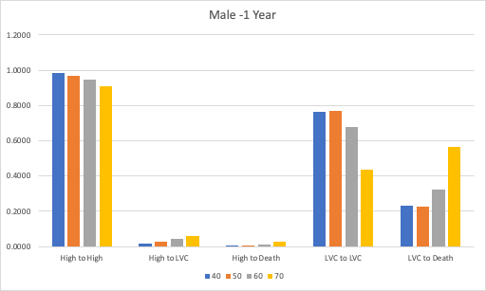
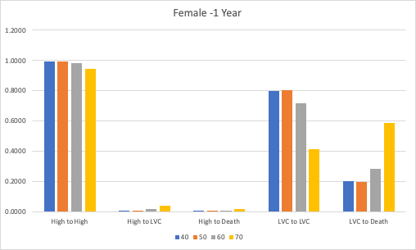
Markov Model - HBV Transition Probability (1 Year)
HJ. Kwon
Progress Report
NCC-GCSP

Slide 9
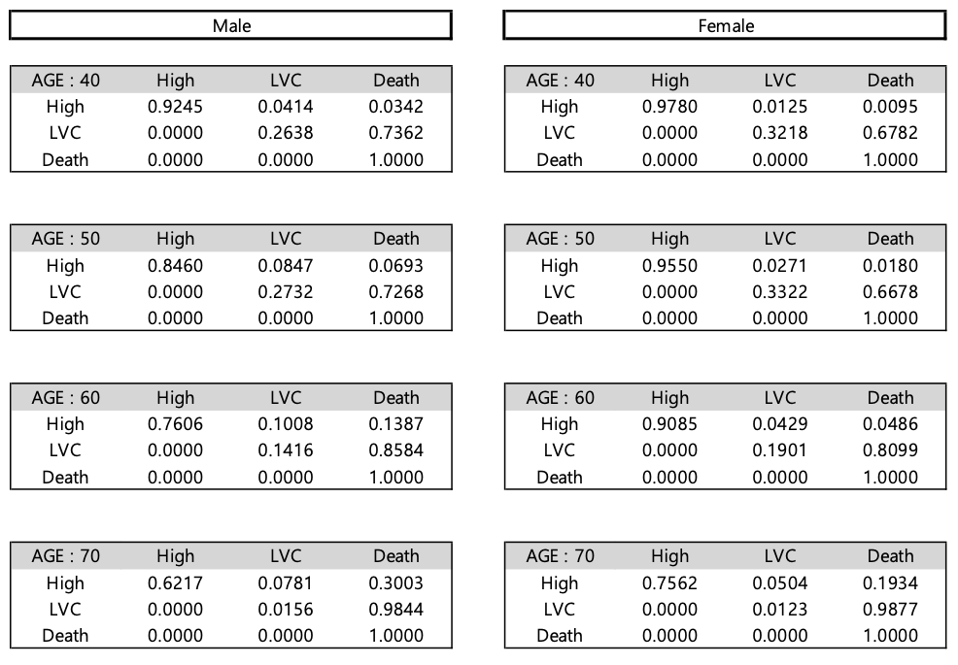
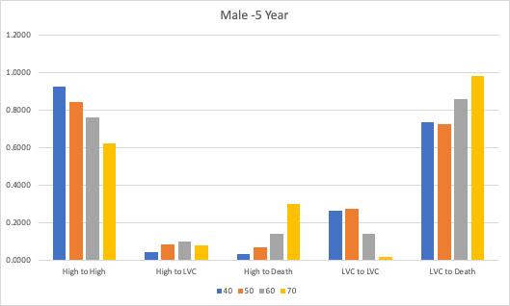
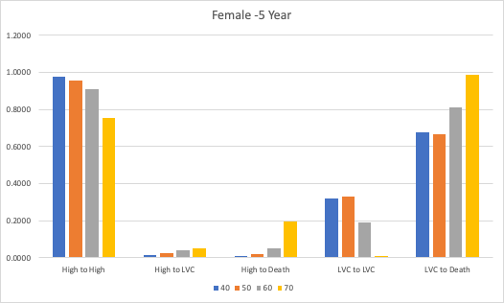
Markov Model - HBV Transition Probability (5 Year)
HJ. Kwon
Progress Report
NCC-GCSP

Slide 10
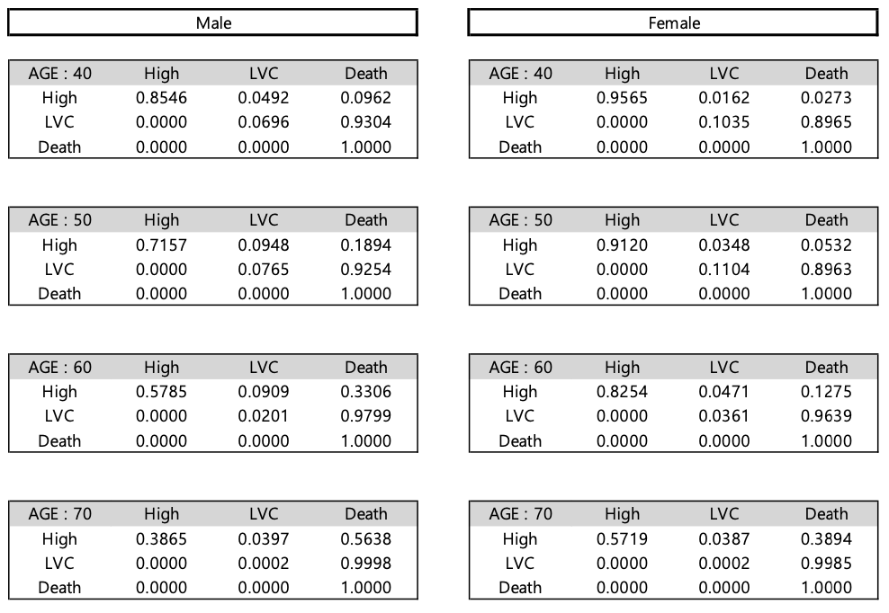
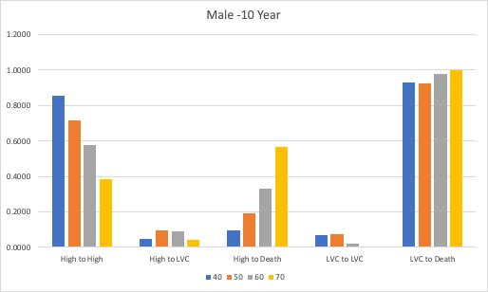
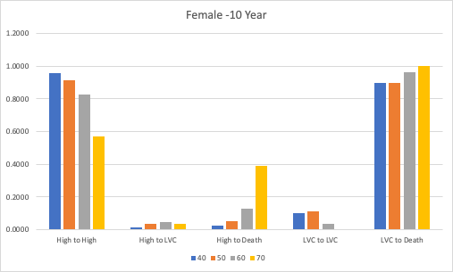
Markov Model - HBV Transition Probability (10 Year)
HJ. Kwon
Progress Report
NCC-GCSP

Slide 11
Markov Model - HBV Transition Probability
HJ. Kwon
Progress Report
NCC-GCSP

Slide 12
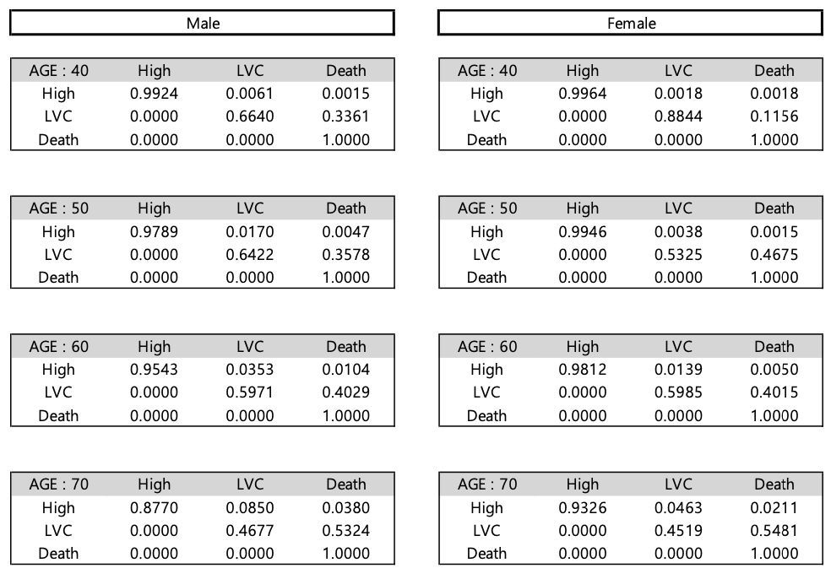
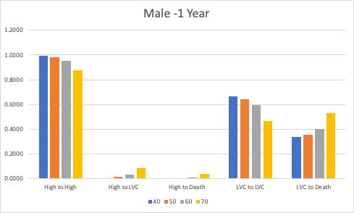
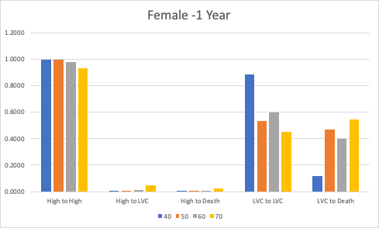
Markov Model - HCV Transition Probability (1 Year)
HJ. Kwon
Progress Report
NCC-GCSP

Slide 13
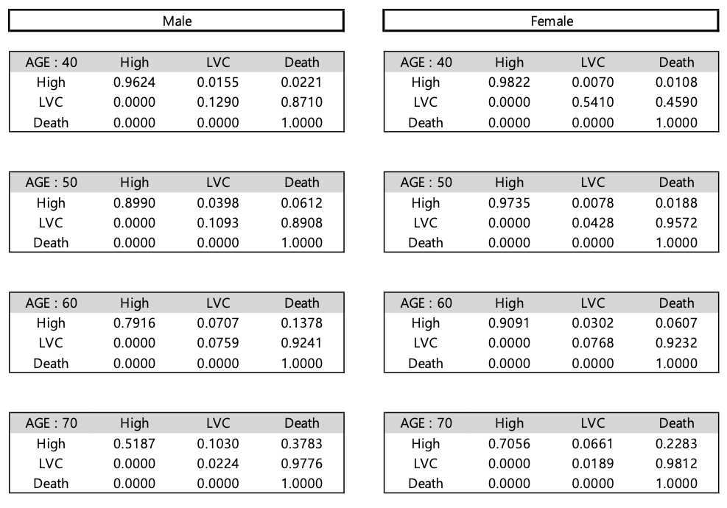
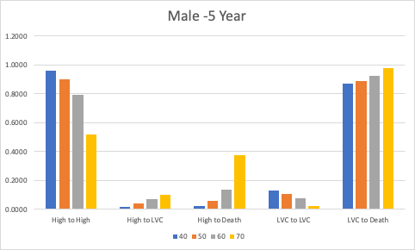
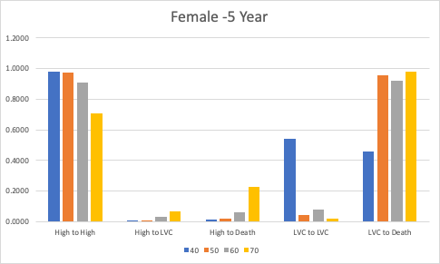
Markov Model - HCV Transition Probability (5 Year)
HJ. Kwon
Progress Report
NCC-GCSP

Slide 14
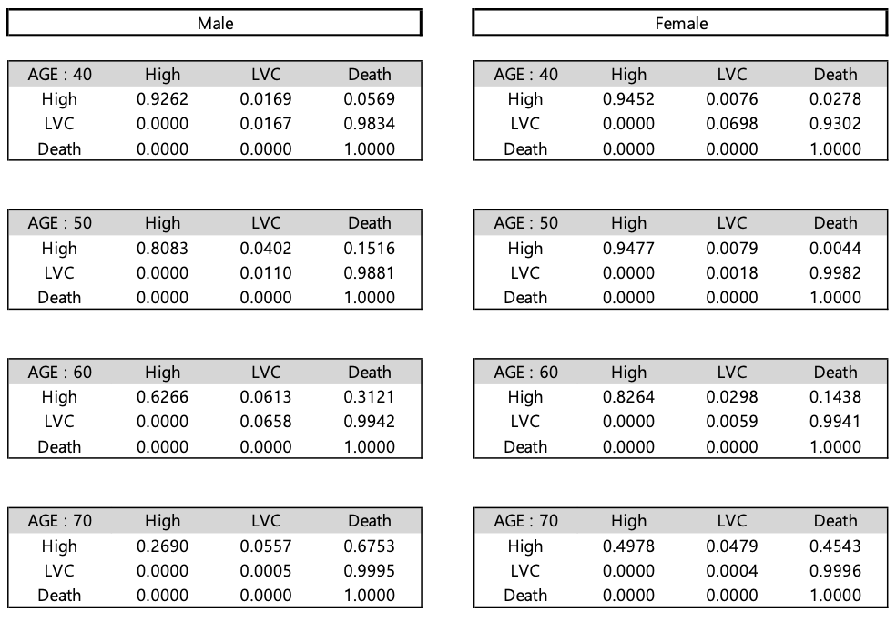
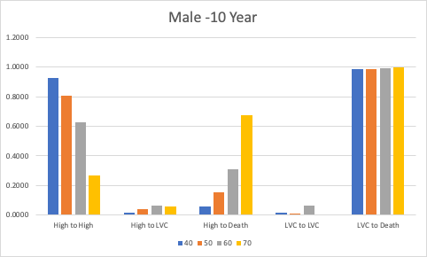
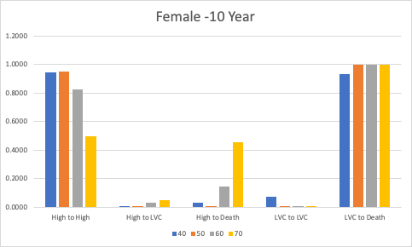
Markov Model - HCV Transition Probability (10 Year)
HJ. Kwon
Progress Report
NCC-GCSP

Slide 15
Markov Model - HCV Transition Probability
HJ. Kwon
Progress Report
NCC-GCSP

Slide 16
Markov Model - Completed Model Status
Sub Model
(DM, FLD, ALC)
Full Model
(Sub Model + SMK,OBE,FH)
☑
△
HBV
!
HBV
☑
△
CCI
HCV
!
HCV
☑
△
Others
!
Others
Total
Total
HJ. Kwon
Progress Report
NCC-GCSP

